Slide 1
Beazley gpas and Billing OPERATING MODEL
Ways of Working for GPAS Programme Delivery – DRAFT v0.1
Drafted: Mar-2024

Slide 2
  Document change history
S.No | Version | Month/Date | Changes made
1. | 0.1 | March-2024 | First version of Ways of working, focused more at Inception phase method & processes
2 | 0.2 | 17th March 2024 | Updates made basis feedback received from Warren – changes made to Team structure Warren to come back on Sign-off names from Beazley for Inception deliverables
3 | 0.3 | 19th March 2024 | Updates to Core team based on Beazley feedback, text changes on context slide, Removed names against responsibilities for Beazley, Added GPAS and Billing in the RACI, New integration entry in RACI, Removed the approvers and sign-off to be updated later once Beazley confirms
4 | 0.4 | 25th March 2024 | Updates to RACI, Two in a Box Structure and other minor changes

Slide 3
CONTEXT
Ways of working is a Capgemini recommended way of Program execution allowing all relevant parties and stakeholders to operate and collaborate towards achieving the common program goals. This document intends to target both processes and behaviours that form the building blocks of successful completion of GPAS
This Ways of working is specifically designed for GPAS and Billing scope of work only and for the scope of work owned by Capgemini. The processes, behaviours and recommendations outlined here may not be applicable outside GPAS to the wider Modernization program
The Ways of working document is expected to evolve iteratively, through Inception phase before it can be made final. However, throughout the GPAS program execution, the delivery method or process may undergo change in certain sections if all the influenced parties agree there is a need for improvement

Slide 4
Ways of working
The immediate focus is to draft and agree on Ways of working applicable for the start of Inception phase covering activities, deliverables, methods and processes expected to be jointly built and done by Capgemini and Beazley. As a next step, this document will be extended to document methods and processes applicable to the Build phase.
To be built & agreed for start of Inception
INCEPTION PHASE
Scope of Inception phase
Key Success factors
Inception activities – week wise split
Workshops – rules of engagement
Inception phase deliverables
Team Structure for Inception
Design Principles
RACI
Key roles – Beazley and Capgemini
Governance – Key roles, Cadence, Escalation, Change Control
Tools for Inception
JIRA set-up and governance
BUILD PHASE
To be built & agreed in parallel to Inception for start of build
  Foundation & Waves Construct
  Backlog management process
  Sprint construct
  Cadence and ceremonies
  User story management
  Activities list
  DoD and DoR - Definition of Done and Definition of Ready
  Third party alignments and SLA
  Metrics & Reporting
  Collaboration and Tool sets

Slide 5





Programme Inception phase helps create the foundation & vision of the Transformation
A common 12-weeks Programme Inception phase to clarify and align the scope in all Products for a Foundation,
followed by the implementation of the planned Releases.
Programme Inception
Design and Build
Programme Inception is focused on “Designing the next winning proposition”
Foundation Release Mobilization is focused on enabling MVP Design and Build to start
Build the foundation with core principles intact. – data/ automation / experience
Collaborative pre-work on entry criteria to ensure rapid start and timely completion
Transform the plan from the Inception to reality, transforming the business requirements to functional systems
Plan for future Releases and LOB
Confirm Roll-out Approach
Key Design Decisions log
What you’ll get:
Prioritized backlog
High Level Design
Foundation release plan
Key risks & assumptions
Dependencies detailed

Slide 6

KEY SUCCESS FACTORS
Right Time
  Multi-day sessions
  Aligned workshops
  Covering India, UK and US time zone
Outputs more focused at Foundation release
GPAS Ways of working
Prioritized Backlog
Effort & Resourcing
GPAS & Billing HLD and Delivery Plan
Key Design Decisions
Migration Strategy
Integration Inventory
Dependency tracker
Test Strategy
Rationalized Product set
Pebbles / Rocks / Boulders
Categorizing elements of solution for appropriate escalation to finalise scope
Right Inputs
  Product / Process Design
  OOTB Guidewire Process Flows
  Interfaces
COLLABORATION
AGILE
MATURITY
Right Team
  Product Owners, Business SME
  Right Capgemini team
  Collaboration is key
DEPENDENCIES MANAGEMENT
Right Enablers
  Guidewire Instance
  Collab Tools
  Reliable access to VDIs
Right Decisions
  Timely & accurate decisions
  On time escalations for help
  Lean thinking
Inception Phase Principles
OOTB Conformance
Business Priority / Rationale
Design for Future

Slide 7
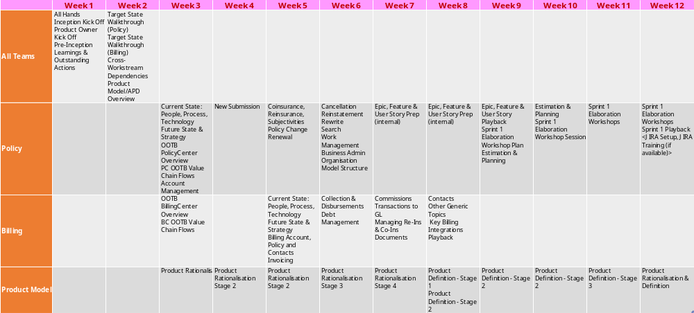
INCEPTION PLAN – By WEEK BREAKDOWN
The Inception plan will be shared separately for Beazley’s review and preparation for start
Workshops - Tuesday, Wednesday, Thursday
(AM: 10-12:30
PM-13:30-17:00)

Slide 8






Guidelines for meetings and workshops
Rules of Engagement
  All meeting and workshop invites to include:
    Purpose of the meeting / Agenda
    Input to the meeting
    Expected output from the meeting
    Deliverable(s) output (as required)
  Be straight and transparent
  Business attendees and availability to be confirmed by Beazley (Senior Product Owner/relevant Product Owner) before invitation is sent
  Parking lots/Decision logs to be captured and logged in the required trackers
  Critical decisions to go through appropriate Programme Governance forums and documentation
  On site and remote attendance options to be available
  Recording of sessions to be used where appropriate
  All sessions to be aligned to overall programme strategy
  All material to be utilised for Beazley programme purposes only
Notes:
3 mins
Cloud Assurance – feedback highest standard of code globally. Jointly work with them
GW embedded within the team
Fully connected Delivery teams
Clear points of escalation
Lean/Scalable governance model

Slide 9
Inception programme deliverable outputs
Deliverables at programme level & expected signatories
Deliverables to be produced during Inception, ready for review and response feedback loop. All deliverables to have a wider review distribution which will be confirmed on the deliverable itself.
Functional Activities
Obtain an understanding of in scope functional areas
Obtain and understanding of as is current processes
Receive demos of current systems
Review the existing capability map and identify any gaps
Deliverable Names | High level Description and Expectation | Review | Sign Off
PD1: GPAS Ways of Working | Detailed methodology, Governance model, Change control model, communication management, Reporting & meeting cadence, Initial team structure, RACI, Escalation approach, Tools for build & usage boundaries | TBD | TBD
PD2: Prioritized Backlog (Foundation) | Documentation of Foundation Release Functional requirements, in scope Epics/Features. User Stories scope statement defined in excel format for uploading into JIRA | TBD | TBD
PD3: Resourcing & Efforts (Foundation) | Breakdown of resourcing needs (by quarter) aligned to effort and bottom-up estimation of Epics and Features against the delivery plan. High level scope, budget, and resourcing/effort should reconcile. | TBD | TBD
PD4: Delivery Structure & Plan (Foundation) | Phase & Workstream definitions, objectives and milestones. Verification and Acceptance. Plan detailing the Guidewire sprint plan, number of sprints, dates, and high-level proposed scope breakdown. | TBD | TBD
PD5: GPAS High Level Design | Aligned to agreed architecture decisions and principles Detail how Policy and Billing Center will fit into Beazley ecosystem. Detail the key Integrations for the Foundation release | TBD | TBD
PD6: Migration Strategy | Approach to migration in terms of execution and timing. High-level data requirements at an entity level, from relevant business areas. | TBD | TBD
PD7: Integration Manifest | Inventory of integrations defining cardinality, service contract ownership, integration pattern or method, initial view on complexity. Definition of any intermediated services or gateways to influence design. | TBD | TBD
Notes:
3 mins
Cloud Assurance – feedback highest standard of code globally. Jointly work with them
GW embedded within the team
Fully connected Delivery teams
Clear points of escalation
Lean/Scalable governance model

Slide 10
Inception programme deliverable outputs
Deliverables at programme level & expected signatories
Functional Activities
Obtain an understanding of in scope functional areas
Obtain and understanding of as is current processes
Receive demos of current systems
Review the existing capability map and identify any gaps
Deliverables to be produced during Inception, ready for review and response feedback loop. All deliverables to have a wider review distribution which will be confirmed on the deliverable itself
Deliverable Names | High level Description and Expectation | Reviewer | Sign Off
PD8: Detailed Dependency Tracker | Internal and External Dependencies detailed with dates and deliverables agreed with each of the related parties. | TBD | TBD
PD9: Functional & Technical Principals | Functional and Technical Design principles documented. | TBD | TBD
PD10: GPAS Test Strategy | High level scope of key test phases, gates and entry/exit criteria; view of resourcing. Input into Definition of Done (DoD) including acceptance criteria, automation definition. Definition of the GPAS environment requirements and when they will be required by to meet the timelines. | TBD | TBD
PD11: Product Set | Rationalised product set for foundation release Identification of any products requiring further analysis and key decision papers where necessary. | TBD | TBD
Notes:
3 mins
Cloud Assurance – feedback highest standard of code globally. Jointly work with them
GW embedded within the team
Fully connected Delivery teams
Clear points of escalation
Lean/Scalable governance model

Slide 11
Teams for inception and Beyond…
Beazley
Capgemini
Business Sponsors / Delivery Exec
Barry Houston
Vanesssa Ortega
Akhlas Hafiz
Dauda Jammeh
Programme Directors
Max Cartwright
Warren Pilkington
Delivery Leads
Ananda Arasu Ponnaiah
(UK)
Natraj Gudla
(India)
Athik Miah
(Billing)
Stephen Payne
Product Owner
Abby Vredenburg
(Business Process)
TBD
(Policy)
Patrycja Kuligowska
(Billing)
Functional Leads
Sherezad Contractor
(Policy)
Sriram Jagannathan
(Billing)
Subject Matter Experts
Devin Wells
(Policy)
Kerstin Kasdorf
(Process excellence)
Steve Flood
(Claims)
Saad Jassani
(Process Excellence)
Subu Ramasundaram
(Process Excellence)
Molly Spolarich
(Operations)
Carol Hamilton
(Billing)
Alejandro Gonzalvez Suarez
(Billing)
Sarah Carroll
(Billing)
Jonathan Abbott
(Billing)
Dominik Dyszkowski
(Billing)
Architects
Brett Fabian-Smith
Jigar Solanki
Dean Johnston
(Enterprise Architect)
Matt Reynolds
(Business Architect)
Danny Sohal
(Finance EA)
Marta Latuszek
(Finance Business Architect)
Current Platform Owners
Jeff Colandrea
(Beazley Pro)
Devin Wells
Mark Parlsey
Antonio Seager
(Finance)
Technical Leads
Vamshi Chennamadhavuni
(Guidewire)
Rajesh Bandaru
(Policy)
Gourab Marik
(Integration)
Balaji KV
(Billing)
Test Manager
SivaramaKrishna Narayanan
TBD (from Hexaware)
Product Rationalization
Peter Dixon
Kelly Reisling
Jeff Colandrea
Matt Reynolds
Troy Baillargeon
Steve Enness
U/W SMEs..TBD
Migration
Andy Ford (BA)
Anita Param (BA)
Procurement
Ian Craney
Ben Lowles
Dev Ops
TBD
TBD
Notes:
Platform owners – Jeff owns Beazley Pro and reports into IT

Slide 12
Teams for inception and Beyond…
Beazley
Capgemini
Business Sponsors / Delivery Exec
Barry Houston
Vanesssa Ortega
Akhlas Hafiz
Dauda Jammeh
Programme Directors
Max Cartwright
Warren Pilkington
Delivery Leads
Ananda Arasu Ponnaiah
Natraj Gudla
Athik Miah
(Billing)
Stephen Payne
Product Owner
Abby Vredenburg
(Business Process)
TBD
(Policy)
Patrycja Kuligowska
(Billing)
Functional Leads
Sherezad Contractor
(Policy)
Sriram Jagannathan
(Billing)
Subject Matter Experts
Devin Wells
(Policy)
Kerstin Kasdorf
(Process excellence)
Steve Flood
(Claims)
Saad Jassani
(Process Excellence)
Subu Ramasundaram
(Process Excellence)
Molly Spolarich
(Operations)
Architects
Brett Fabian-Smith
Jigar Solanki
Dean Johnston
Matt Reynolds
Current Platform Owners
Jeff Colandrea
Devin Wells
Mark Parlsey
Technical Leads
Vamshi Chennamadhavuni
(Guidewire)
Rajesh Bandaru
(Policy)
Gourab Marik
(Integration)
Balaji KV
(Billing)
Test Manager
SivaramaKrishna Narayanan
TBD (from Hexaware)
Product Rationalization
Peter Dixon
Kelly Reisling
Jeff Colandrea
Matt Reynolds
Troy Baillargeon
Steve Enness
U/W SMEs..TBD
Migration
Andy Ford (BA)
Anita Param (BA)
Procurement
Ian Craney
Ben Lowles
Dev Ops
TBD
TBD
Notes:
Platform owners – Jeff owns Beazley Pro and reports into IT

Slide 13



GPAS & BILLING – DRAFT STRUCTURE v0.2
Risk Board
(see previous slide)
Other Programme Stakeholders
Key:
Capgemini
Key Cross-Programme Delivery Support
Beazley
Product Rationalis-ation
Jeff Colandrea
(Platform Owner)
Devin Wells
(Policy SME)
Matt Reynolds
(Bus. Architecture)
Peter Dixon
(Prod Rationalisation)
Guidewire
Modernisation Steering Group
See previous Slide)
TBD – Cap/Beazley/GW
US Based
Abby
Vredenburg
(Bus Proc PO)
Steve Flood
(Claims SME)
Troy Baillargeon (Prod Rationalisation)
Kelly Reisling
(Prod Rationalisation)
Executive Leadership
Akhlas Hafiz
(Head of Modernisation)
Vanessa Ortega (Business Owner)
Ben Lowles
(Procurement Lead)
Canada Based
TBD
(Prod Rationalis’n BA)
TBD
(Prod Rationalis’n BA)
TBD
(Data Team Reps)
TBD
(UW SMEs)
India Based
Dauda Jammeh
(Bus Owner - Finance)
Barry Houston
(Delivery Exec)
Ian Craney
(Procurement Lead)
Process Excellence
Abby
Vredenburg
(Bus Proc PO)
Saad Jassani
(Process SME)
Kerstin Kasdorf
(Process SME)
Subu Ramasundaram
(Process SME)
Stephan Benet-Weiler / Aine Kane (Del Exec)
Infra / DevOps
Simon Fry
(Infrastructure)
TBD
(DevOps)
TBD
(DevOps)
Program Leadership
Warren Pilkington (Prog Director)
TBD
(Lead GPAS PO)
Stephen Payne
(Del Lead – GPAS & Billing)
Owen Humphries
(Technical Lead)
Dean Johnston
(Ent Architecture)
Jeff Colandrea
(Platform Owner)
Business Analysis
Alejandro Gonzalvez Suarez (BA)
Anita Param
(Migration BA)
TBD
(Process Design BA)
Max Cartwright
(Prog Director)
TBD
(Lead Finance PO)
Athik Miah
(Del Lead - Billing)
Natraj Gudla
(Del lead – India)
Danny Sohal
(Finance Architect)
Dominik Dyszkowski
(BA)
Andy Ford
(Migration BA)
TBD
(Prod Rational^{n} BA)
TBD
(Functional Lead)
Ananda A Ponnaiah
(Del Lead UK)
Frederic Brunner
(Delivery Director)
Brett Fabian-Smith
(Ent Architect)
SMEs
Devin Wells
(Policy SME)
Sarah Carrol
(Billing)
Carol Hamilton
(Credit Control NA)
Steve Enness
(Prod Rationalisation)
TBD
(GW Ent Architect)
Steve Flood
(Claims SME)
Molly Spolarich
(Operations SME)
Troy Baillargeon (Prod Rationalisation)
Jonathan Abbott
(Billing)
POs, Functional & Technical Leads
Kerstin Kasdorf
(Policy PO)
Patrycja Kuligowska
(Billing PO)
TBD
(Integration Lead)
TBD
(Data Lead)
TBD
(Docs Lead)
TBD
(Migration Lead)
TBD (Hexaware)
(Test Mgr)
TBD (Training / Bus Readiness Lead)
Current Plat. Owners
Jeff Colandrea
(BeazleyPro)
Mark Parlsey
(TBD)
Devin Wells
(TBD)
Antonia Seager
(Finance)
Sherezad Contractor
(PC Func Ld)
Sriram Jagannathan
(BC Func Ld)
Gourab Marikm
(GW Int. Lead)
TBD
(Policy Mig’n Lead)
SivaramaKrishna Narayanan
(Test Manager)
Architects
Matt Reynolds
(Bus Arch)
TBD
(Solution Architect)
TBD (GW Assurance Architect)
Rajesh Bandaru
(PC Tech Ld)
Balaji KV
(BC Technical Lead)
Vamshi C
(Guidewire Lead)
Marta Latuszek
(Fin Architect)
Jigar Solanki
(Solution Architect)
TBD
(GW PC Lead)
TBD
(GW BC Lead)
TBD
(GW Int Lead)
Shared Services SMEs
TBD
(IT Security)
TBD
(Risk)
PAS BAU transition (based on ITOM/BAU Serv Mgmnt Structure)
Delivery Teams (see over)
TBD
(Audit)
TBD
(Compliance)

Slide 14
GPAS & BILLING – DRAFT STRUCTURE (+DEVELOPMENT) v0.2
Executive Leadership
Product Rationalis-ation
Program Leadership
POs, Functional & Technical Leads
Process Excellence
Delivery Teams
Foundation Release
(High Level)
Policy Lead
Billing Lead
Integration Lead
Data Lead
Docs Lead
Migration Lead
Testing Lead
Training & Business Readiness
Infra / DevOps
Product Owner
Business SMEs
Business Analysts
Scrum Master
Dev Lead
Developers
GW Consultants
Business Analyst
Tech Lead
Developers
Testers
Business Analysts
Product Owner
Business SMEs
Developers
GW Consultants
Business Analyst
Tech Lead
Developers
Testers
Technical SMEs
Developers
GW Consultants
Business / Mapping Analyst
Tech Lead
Developers
Testers
Product Owner
Business SMEs
Technical SMEs
Business / Data Analyst
Data Developers
Testers
Product Owner
Business SMEs
Technical SMEs
Business / Docs Analyst
Docs Developers
Testers
Product Owner
Business SMEs
Technical SMEs
Business / Migration Analyst
Migration Developers
Testers
UAT Testers
SIT Testers
Business Readiness Lead
Training and Communication Lead
Model Office Lead
Business Analysis
UK
SMEs
India
Current Plat. Owners
Architects
Automation Testers
Shared Services
Key:
Capgemini
Beazley
Combined Teams
Guidewire

Slide 15
Design principles
All key decisions to move through formal programme governance decision bodies
Does the decision:
Decision making process:
support the agreed Release scope?
Workshop/Meeting where key question arises
ensure the business is not in a worse position from before?
Identification of key decision needed, decision owner and required inputs to enable decision
Creation of key decision paper and supporting material(s)
support a move off existing systems
Presentation at BDA/TDA or both as required
support flexibility and maintainability for future releases?
BDA/TDA decision output documented and stored
abide by the Beazley architectural principles?
Ratification of BDA/TDA decision output at Programme Leadership/Steering if required
allow for scalability and is not closed off for future-states
Notes:
3 mins
Cloud Assurance – feedback highest standard of code globally. Jointly work with them
GW embedded within the team
Fully connected Delivery teams
Clear points of escalation
Lean/Scalable governance model

Slide 16

KEY AREAS – raci [1]
Area |  | Beazley |  | Capg |  | Guidewire
Modernization Program Activities |  | A |  | C |  | I
Program planning & delivery
Ways of working for all Programs under Modernization
Procurement Management
Program communications and stakeholder management
SteerCo & Leadership reporting
PMO |  | A |  | C |  | I
Risk and Issue Management tracking
Dependency Mangement tracking
Programme Metrics & Milestone tracking
Programme Budget & Invoicing payments tracking
Project infra needs set up coordination & tracking
Deliverables tracking
Requirements Gathering and Management (GPAS & Billing) |  | A |  | R |  | C
Product Backlog refinement and Business process mapping
User story refinement with business rules and acceptance criteria
Requirements sign-off
Prototyping and mock-ups
Workshops schedule, execution & follow-up
Architecture and Technical Management (GPAS and Billing) |  | A/R |  | R |  | R
Confirm Architecture and Design Principles
High level designs
Create and maintain Technical Design Decisions
Low level design
Data Migration Strategy
Environments and Infrastructure |  | A/R |  | C |  | R
Infrastructure and environments planning and provisioning
Deployments, maintainence and supplier issues resolution
Capacity planning & scalability
Security and Compliance implementation
Monitoring, management & performance optimisation
Area |  | Beazley |  | Capg |  | Guidewire
GPAS and Billing Delivery |  | C |  | A/R |  | C
Develop user stories adhering to Guidewire Cloud standards
Unit testing adhering to Guidewire Cloud Standards
Sprint plan and raising dependencies
Resolve Guidewire Cloud standard assessment observations
Sprint progress reporting
E2E Testing |  | A/R |  | C |  | I
End to End Test Strategy and Execution
JIRA and Confluence set-up
Metrics and Reporting
Risks and Issues management
Defects resolution specific to GPAS & Billing components |  | C |  | A/R |  | C
GPAS and Billing Functional Testing |  | A |  | R |  | I
Functional test plan and execution
Risks, Issues and Dependencies status reporting
Metrics and Reporting using JIRA
Release Management |  | A |  | C |  | C
End to end release plan roadmap for the Program
Strategy, Processes and teams for deployments, check points
Third party coordination for all environments
Cutover, Go-live and Post Go-live Support |  | A/R |  | R |  | R
Cut-over plan and Implementation Management
Establish post Go-live Support Model
Infrastructure and environments set-up
Service Design and PGLS Plan
Incident fixes specific to GPAS & Billing during warranty |  | C |  | A/R |  | C
Key
A | Accountable | Authority and decision making
R | Responsible | Responsible for actualisation of the task
C | Consulted | Engaged stakeholder, consulted in decisions, delivery and approach to enable their input
I | Informed | Informed stakeholder receiving updates and outputs only
Notes:
3 mins
Cloud Assurance – feedback highest standard of code globally. Jointly work with them
GW embedded within the team
Fully connected Delivery teams
Clear points of escalation
Lean/Scalable governance model

Slide 17
KEY AREAS – raci [2]
Area |  | Beazley |  | Capg |  | Guidewire
Business Change Management |  | A |  | C |  | I
Change Impact assessment and readiness
Business roll-out plan
Communications and reporting
Legacy |  | A/R |  | C |  | I
Management of legacy party stakeholders
Delivery of dependencies as per Program plan
Management of design, build and testing required by GPAS & Billing
Communication on Legacy changes that impact GPAS & Billing
Status updates and reporting
Finance (Subledger) |  | A/R |  | C |  | I
Management of Finance party stakeholders
Delivery of dependencies as per Program plan
Management of design, build and testing required by GPAS & Billing
Communication on Finance changes that impact GPAS & Billing
Status updates and reporting
Documents |  | A/R |  | C |  | I
Document supplier and platform management
Deliver Document platform dependencies as per Program plan
Documents design
Document template requirements, build and test
Environment and Infrastructure management
Data & Analytics |  | A/R |  | I |  | I
Data Management Strategy
Data & Analytics build and test
Analytics Reporting requirements & build
Dependency management with rest of the Program
CDA
Area |  | Beazley |  | Capg |  | Guidewire
Third Parties (Integrations & Guidewire) |  | A/R |  | C |  | I
Third party management
Third party deliverables alignment to Program plan
Third party environments management
Issues resolution with Third parties
Status updates and reporting
Policy Data Migration
E2E Oversight |  | A/R |  | C |  | I
Legacy Data management
Data Migration Strategy |  |  |  | R
Data Profiling with production data
Data Migration technical solution
Data Migration mapping and gap analysis
Data Migration implementation and Go-live strategy
UWWB (Underwriting Work Bench) |  | A |  | C |  | I
Requirements management
Deliverables alignment to Program plan
Environments management
Issues resolution impacting Program
Status updates and reporting
GPAS and Billing Integration - External (third party) and Internal (Beazley systems) |  | A/R |  | R |  | I
Integrations design
Integrations inventory
High Level Design
Low Level Design
Technical mapping document
Plan, Build and unit test integrations
Key
A | Accountable | Authority and decision making
R | Responsible | Responsible for actualisation of the task
C | Consulted | Engaged stakeholder, consulted in decisions, delivery and approach to enable their input
I | Informed | Informed stakeholder receiving updates and outputs only
Notes:
3 mins
Cloud Assurance – feedback highest standard of code globally. Jointly work with them
GW embedded within the team
Fully connected Delivery teams
Clear points of escalation
Lean/Scalable governance model

Slide 18
KEY ROLES – Beazley
Role | Named Resource | Responsibilities
Business Owner/ Sponsor |  | Approve scope, target design and execution plans for the PAS iniaitive. Accountable for delivery against OKRs, business outcomes and benefit realisation. Commits or helps facilitate appropriate resources (e.g. SMEs) and support issue resolution for the PAS initiative. Approve and oversee key initiative decisions as adviser Steer solution design and build based on business needs
PAS Delivery Lead |  | Develop the initiative objectives, scope, highlevel implementation roadmap, resource requirements and investment estimates. Working with the delivery partners, create and manage the PAS delivery plans. Manage the delivery teams inc. resource management, supply & demand, technical capability and skills Manage inbound and outbound dependencies needed for the delivery of the component Management of risks and issues impacting progress Responsible for status reporting of the project
Global PAS Product / Platform Lead |  | Helps define the PAS Product Strategy, Vision and Roadmaps alongside the Product Owners in the PAS initiative. Managing and prioritising the PAS Portfolio Backlog taking care to ensure alignment with business architecture, data teams and existing BAU environments. Delivering Value by ensuring the PAS solutions are complete from the user perspective (including operations, change etc) and deliver meaningful business value. Point of escalation and coaching for squad-level Product Owners.
Solution Architect Lead |  | Work with squads to define target technical solutions. Gain approval through Design Authority for technical solutions. Monitor technical risk and mitigation control. Define technical guardrails for delivery squads. Embed technical work into backlogs of delivery squads.
Product Owner |  | There will be different Product Leads depending on the release/wave of PAS implementation. For example, Cyber and D&O in Foundation release. Understand and be able to describe the end-to-end solution in a high level, the use cases and related business drivers. Attend decision making sessions, feeding input regarding the product and its interaction with other components, acting as a point of reference for the product required features and behaviour. Understand business demands and requirements and translate these into solutions that are refined iteratively and present them to the team. Prioritise requirements of the product and make adjustments as needed after each release. Define the future goal of the product (the ‘product vision’) Maintain and own the product backlog. Accepting or rejecting suggested improvements. Report progress, involvement in governance arrangements.
Scrum Master |  | Responsible for the effective and consistent operational performance for the scrum process. Responsible for both timely and effective tracking and reporting on team progress against goals. Responsible for managing team capacity, utilisation and velocity. Responsible for providing Delivery Lead and Product Owners with relevant input for each team member to support each team member’s development and performance needs.
Notes:
3 mins
Cloud Assurance – feedback highest standard of code globally. Jointly work with them
GW embedded within the team
Fully connected Delivery teams
Clear points of escalation
Lean/Scalable governance model

Slide 19
KEY ROLES – Beazley
Role | Named Resource | Responsibilities
Quality Assurance Testing Lead |  | Ultimately accountable for the quality of the overall end to end solution Provides overall QA oversight for test design and execution, striving for commonality where appropriate Accountable for defining Program level test strategies and approaches for all test phases Accountable for planning and oversight of all test phases, including UAT Provides testing oversight and direction, drives execution of testing strategies and manages testing related objectives and issues across the Program
Release Train Engineer/ Manager |  | Partnering with Product Manager Assisting in management of risks, issues and any potential roadblocks Responsible for resolving contingencies and complicated issues, provide leadership to project teams, and act as a consultant/coach to management Responsible for DevOps and improvement of workflow
Business Architecture Lead |  | Accountable for developing the business architecture strategy Applying structured business architecture approach and methodology Drives and facilitates the right discussions with business leaders to identify business capabilities in relation to current and future business objectives Responsible for presenting recommendations and solutions clearly and concisely Accountable for a specific LOB, business pillar or multiple segments, and high level of complexity and attributes
Change Management Lead |  | Responsible for managing all types of change Evaluates the impact of change Supports development of communications relevant to change initiatives Accountable for defining success metrics and measuring performance against these
Training / Communication |  | Coordinating the development, execution, refinement, and measuring the impact of programme outreach, communications, and knowledge management strategies Responsible for coordinating development of training / learning materials Accountable for the organisation, coordination of workshops and events Responsible for supporting communications, knowledge management, and training activities
Delivery Partners (Third party suppliers to Beazley) |  | Partner with the Senior Delivery Lead Manage the scope of services in support of delivering the PAS initiative Manage the deliverables to be produced in support of delivering the PAS initiative Manage any CRs related to the component and services being provided in support of delivering the PAS initiative Create and manage the plans for the delivery of the services in support of the PAS initiative Manage the delivery squads inc. resource management, supply & demand, technical capability and skills Jointly manage sprint planning, retrospectives and reporting relating to services being provided in support of delivering the PAS initiative Manage inbound and outbound dependencies needed for the delivery of the component Coordinate activities and schedule across the PAS initiative Management of risks and issues impacting progress
Delivery Squads (Beazley SME and/or Third party suppliers to Beazley) |  | End-to-end delivery of each product Provide requested SME input into tasks, activities, decisions Flag risks and issues to the Senior Delivery Lead and/or Delivery Partner Proactive updating of Jira, the backlog and the sprint boards in conjunction with the scrum master
Notes:
3 mins
Cloud Assurance – feedback highest standard of code globally. Jointly work with them
GW embedded within the team
Fully connected Delivery teams
Clear points of escalation
Lean/Scalable governance model

Slide 20
KEY ROLES - capgemini
Role | Named resource | Description
Delivery Executive | Barry Houston | Responsible for overall Services quality and delivery Assist in the resolution of issues and change controls | Prepare for and support Steering/Policy Executive Advisory Group Meetings Monitor program progress
Program Director | Max Catwright | Responsible for in-scope Program activities Provide Program status reporting on a regular basis to Beazley Program and Executive Leadership | Responsible for overall Services quality and delivery of the Program Responsible for day-to-day management and tracking of the in-scope Program activities
Engagement Manager | Ananda Arasu Pommaiah | Manage the detailed Program plan in collaboration with Beazley Leadership Team Provide Program Status reporting on a regular basis to Beazley Program Leadership | Facilitate Decisions, Issues and Risk management across the core program and escalate to Beazley in advance of the materialization of potential risks and issues that may delay the program. Assist the resolution of issues and change controls
India Delivery Executive | Natraj Gudla | Manage the detailed Program plan in collaboration with Beazley Leadership Team Provide Program Status reporting on a regular basis to Beazley Program Leadership | Facilitate Decisions, Issues and Risk management across the core program and escalate to Beazley in advance of the materialization of potential risks and issues that may delay the program. Assist the resolution of issues and change controls
Product Rationalisation | Peter Dixon Kelly Riesling | Provide subject matter specialist advice with regard to overall business requirements and product backlog Provide input on solving business problems within the defined application landscape by working with the business and Technical resources. | Coordinate with Functional Lead and Technical architect to help define implementation scope of work.
Enterprise Architect | Brett Fabian-Smith | Provide leadership and architectural expertise across a broad set of technologies, including integration & middleware technologies Consult with and advise the Program team on technology and strategic decisions | Identify architectural constraints for the architectural level (project, domain, application) based on technical and organizational requirements Provide subject matter specialist advice with regard to overall solution architecture and technology
PolicyCenter Functional Lead | Sherezad Contractor | Provide Policy subject matter experience Work with Beazley business leadership to drive overall business requirements | Provide leadership and direction for elaboration and RSWs Provide joint review and approval of deliverables
BillingCenter Functional Lead | Sriram Jagannathan | Provide Billing subject matter experience Work with Beazley business leadership to drive overall business requirements Provide leadership and direction for elaboration and RSWs | Provide joint review and approval of deliverables Lead with the high-level implementation approach for complex functional requirements
PolicyCenter Technical Lead | Vamshi Chennamadhuveni | Provide subject matter specialist advice with regard to GW PC Conduct configuration option analysis to support business requirements Provide input on GW PC best practices, constraints, and effort during workshops, including pre-work | Provide input on effort and impact associated with potential configurations/customizations Support the Policy Functional Lead with the high-level implementation approach for complex functional requirements
BillingCenter Technical Lead | Sriram Jagannathan | Provide subject matter specialist advice with regard to GW BC Conduct configuration option analysis to support business requirements Provide input on GW PC best practices, constraints, and effort during workshops, including pre-work | Provide input on effort and impact associated with potential configurations/customizations Support the Policy
Integration Lead | Saharsh Gupta Gourab Marik | Provide integration and technical architecture guidance for GW Lead analysis effort of interface specification documents | Lead the integration design effort for specified integration points Provide direction and technical guidance
Notes:
3 mins
Cloud Assurance – feedback highest standard of code globally. Jointly work with them
GW embedded within the team
Fully connected Delivery teams
Clear points of escalation
Lean/Scalable governance model

Slide 21
KEY ROLES - guidewire
Role | Named resource | Description
PolicyCenter Principal Architect | TBD | PolicyCenter technical architect
PolicyCenter Principal Business Analyst | TBD | PolicyCenter functional and product expert
BillingCenter Principal Architect | TBD | BillingCenter architect
Integration Principal Architect | TBD | Guidewire Integration architect
London Market Specialist | TBD | Guidewire London Market and product architect
Guidewire Delivery Management (non-billable part time role) | TBD | Guidewire point of contact for the implementation and Guidewire assigned resourcing.
Guidewire Product (non-billable part time role) | TBD | Guidewire London Market expert and point of liaison with Guidewire product team. Needs to understand the business needs so that any future Guidewire product related enhancements can be planned.
Guidewire Product (non-billable part time role) | TBD | Guidewire London Market expert and point of liaison with Guidewire product team. Needs to understand the business needs so that any future Guidewire product related enhancements can be planned.
Notes:
3 mins
Cloud Assurance – feedback highest standard of code globally. Jointly work with them
GW embedded within the team
Fully connected Delivery teams
Clear points of escalation
Lean/Scalable governance model

Slide 22
governance
The overall success of this engagement will be based on close collaboration between all parties, transparency and fact-based decision making. We will also use this Governance process to keep us all collectively honest and true to the Programme objectives.
Monthly/Quarterly
SteerCo
Reporting
Decisions
Sponsor Review
Change Control Board
Weekly
Leadership Update
Reporting
Technical Design Authority
Business Design Authority
Decisions
Procurement Update
Weekly
Dependency Review Forum
GPAS Programme Management Update
RAID Review
Daily
Agile – Daily Stand-up / Scrum of Scrums
Notes:
3 mins
Cloud Assurance – feedback highest standard of code globally. Jointly work with them
GW embedded within the team
Fully connected Delivery teams
Clear points of escalation
Lean/Scalable governance model

Slide 23
Key
Daily | Weekly | Fortnightly | Monthly | Quarterly
Proposed Programme CADENCE
Daily meetings are reduced timeslots
Steering Committee^{1 –} Usually the last 2 weeks of the month, day and timings can vary
Sponsor Review^{1 –} Occurs every month excluding Steering Committee months
Scrum of Scrums, Dependency Forum and Change Board to start in Inception
Monday
Tuesday
Wednesday
Thursday
Friday
9.00 – 9.30
10.00 – 10.45
11.00 – 12.00
12.00 – 13.00
13.00 – 14.00
14.00 – 15.00
15.00 – 16.00
16.00 – 17.00
Daily Standups
Daily Standups
Daily Standups
Daily Standups
Daily Standups
Scrum of Scrums
Scrum of Scrums
Scrum of Scrums
Scrum of Scrums
Scrum of Scrums
Leadership Stand-Up
Procurement Update
Business Update
PMO RAID review
Dependency Forum
Change Board
Technical Design Authority
Business Design Authority
Steering Committee¹
Programme Management Update
Sponsor Review²
Notes:
3 mins
Cloud Assurance – feedback highest standard of code globally. Jointly work with them
GW embedded within the team
Fully connected Delivery teams
Clear points of escalation
Lean/Scalable governance model

Slide 24

Escalation process
Executive Level:
Escalation Etiquette:
Other key stakeholders:
Business Sponsor
Delivery Executive
Account Executive
Escalations
Decisions / Actions
Escalations are done jointly from Capgemini and Beazley representatives from one level to Capgemini & Beazley representatives at the next level up.
Prior to escalation, representatives will work together to:
Agree what they agree on
Agree what they disagree on
Prepare for the escalation, making clear:
  The problem statement
  The options for resolution and their pros and cons
  The decision(s) and / or action(s) required
  The date required by
  The impact of doing nothing / missing the date
Finance modernisation
Underwriting & Servicing
Data Migration
Operations
Programme Director
Programme Director
Delivery Lead
Delivery Lead
Product Owner
Functional Lead
Project Team:
Business SMEs, Business Analysts, Architects, Engineers, UAT team etc.
Business Analysts, Architects, Designers, Engineers, QA / Testers, DevOps, Scrum Masters, Data Scientists
Notes:
3 mins
Cloud Assurance – feedback highest standard of code globally. Jointly work with them
GW embedded within the team
Fully connected Delivery teams
Clear points of escalation
Lean/Scalable governance model

Slide 25
Change control
Controlling change via an agreed process that acknowledges it is needed but manages its impact for the good of delivery is key to the success of this largescale programme delivery.
Change Requestor
Secure Sponsor & Submit CR
Create Change Request
Align on the Gap / Defect / Additional Requirement being a change
Start
Produce the IA
(delivery IA & Business Impact of not proceeding)
Change Implementers
Create / Update User Story
Develop
& Test
Deploy
End
Change Recorder / PMO
Assign CR Ref, Update Change Log, Update CR (with IA) & Drive the Change Control Process
Change Reviewer(s) & Sponsor(s)
Review the CR
Review the IA
Update Scope / Plan / Budget
Consider for Backlog
Change Board
Yes
Yes
Present for Approval to IA
Present for Approval to Deliver
Proceed?
Accept?
No
No
Notes:
3 mins
Cloud Assurance – feedback highest standard of code globally. Jointly work with them
GW embedded within the team
Fully connected Delivery teams
Clear points of escalation
Lean/Scalable governance model

Slide 26
TOOLS FOR INCEPTION
Tools to be provided by Beazley for delivery
Inception
Project Tools
VDI provisioning
Outlook, MS Teams
Project planner
Microsoft Office tools- word, excel, ppt
Guidewire sandbox access
Process and support to raise additional software requests
Lewis Claxton (Beazley PMO)
Managed by
Discovery Tools listed below is not an exhaustive list and will be further built out ….
Dev & Test Team Tools
JIRA
Confluence
Guidewire Platforms
Microsoft Visio
Beazley
Managed by
Notes:
3 mins
Cloud Assurance – feedback highest standard of code globally. Jointly work with them
GW embedded within the team
Fully connected Delivery teams
Clear points of escalation
Lean/Scalable governance model

Slide 27

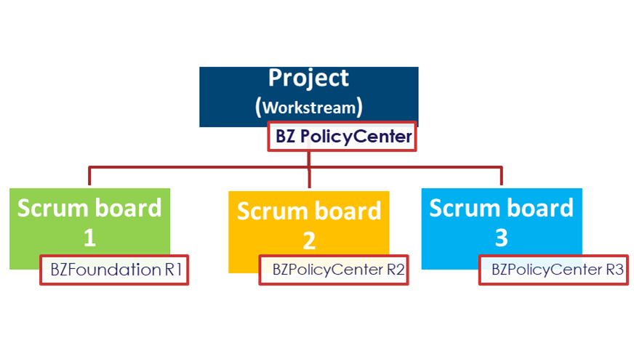
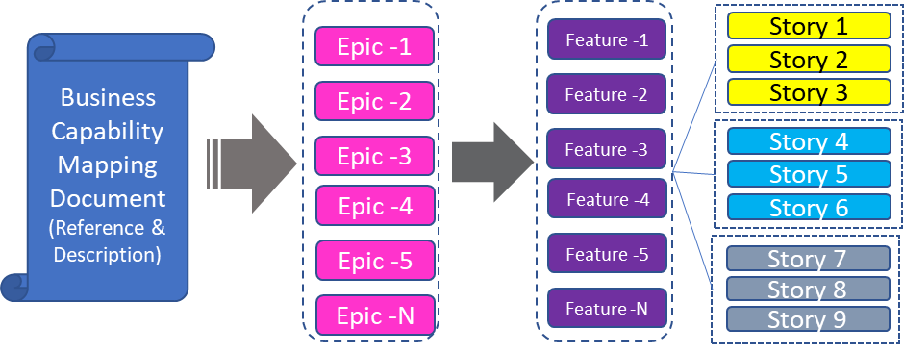
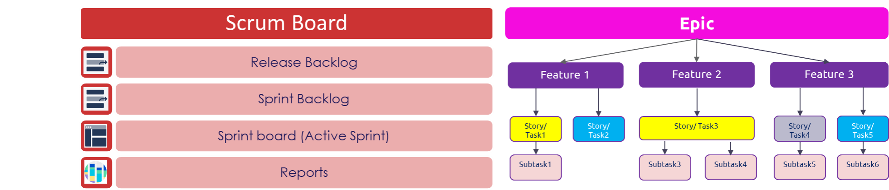
Jira Setup
Process to setup projects in Jira with one scheme configuration and upload prioritized backlog during inception phase
Step1 – Create one Schema Configuration for all GPAS projects
Step2 – Create Projects and set one scheme configuration
GPAS &Billing Projects
Screen Scheme
Workflow Scheme
Issue type Scheme
Permission Scheme
Step3 – Upload the prioritized backlog to GPAS projects
Notes:
3 mins
Cloud Assurance – feedback highest standard of code globally. Jointly work with them
GW embedded within the team
Fully connected Delivery teams
Clear points of escalation
Lean/Scalable governance model

